Slide 1
Equality, Diversity, and Inclusion in Education Educational Hay Day Methodology & Statistics 30-01-2024
Elena Candellone & Hanne Oberman

Slide 2
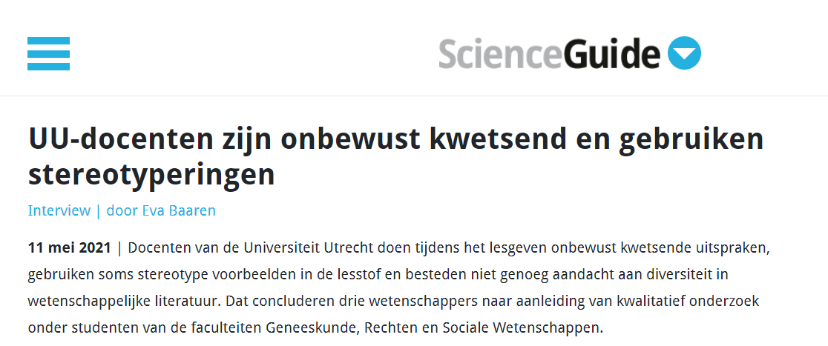
UU lecturers are unconsciously hurtful and use stereotypes
Teachers at Utrecht University unconsciously make hurtful statements while teaching, sometimes use stereotypical examples in the teaching material and do not pay enough attention to diversity in scientific literature. This is the conclusion of three scientists following qualitative research among students from the faculties of Medicine, Law and Social Sciences
UU-docenten zijn onbewust kwetsend en gebruiken stereotyperingen - ScienceGuide

Slide 3
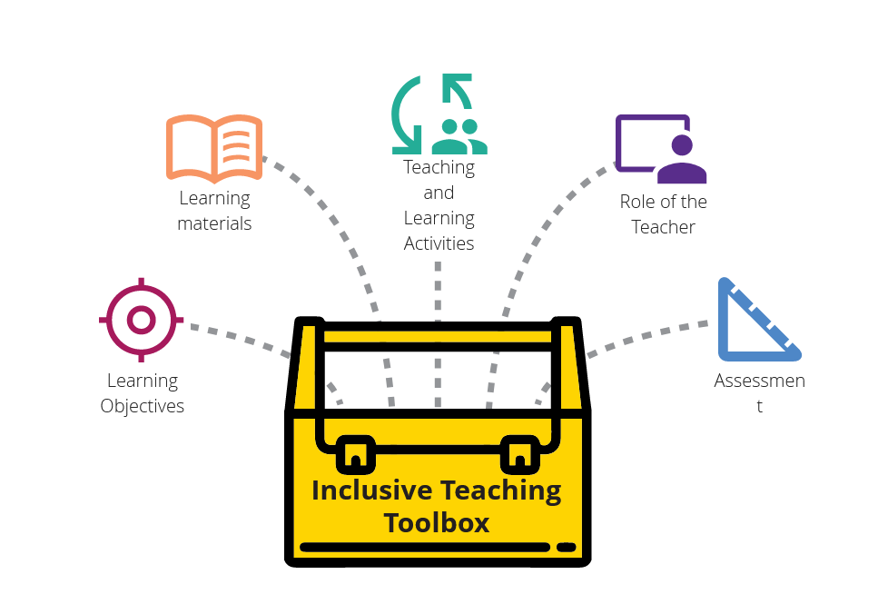
UU Inclusive Teaching Toolbox | Universiteit Utrecht | Home
Inclusive Curriculum and Learning Environment - Utrecht University (uu.nl)
Notes:
Inclusive Curriculum and Learning Environment - Utrecht University (uu.nl)

Slide 4
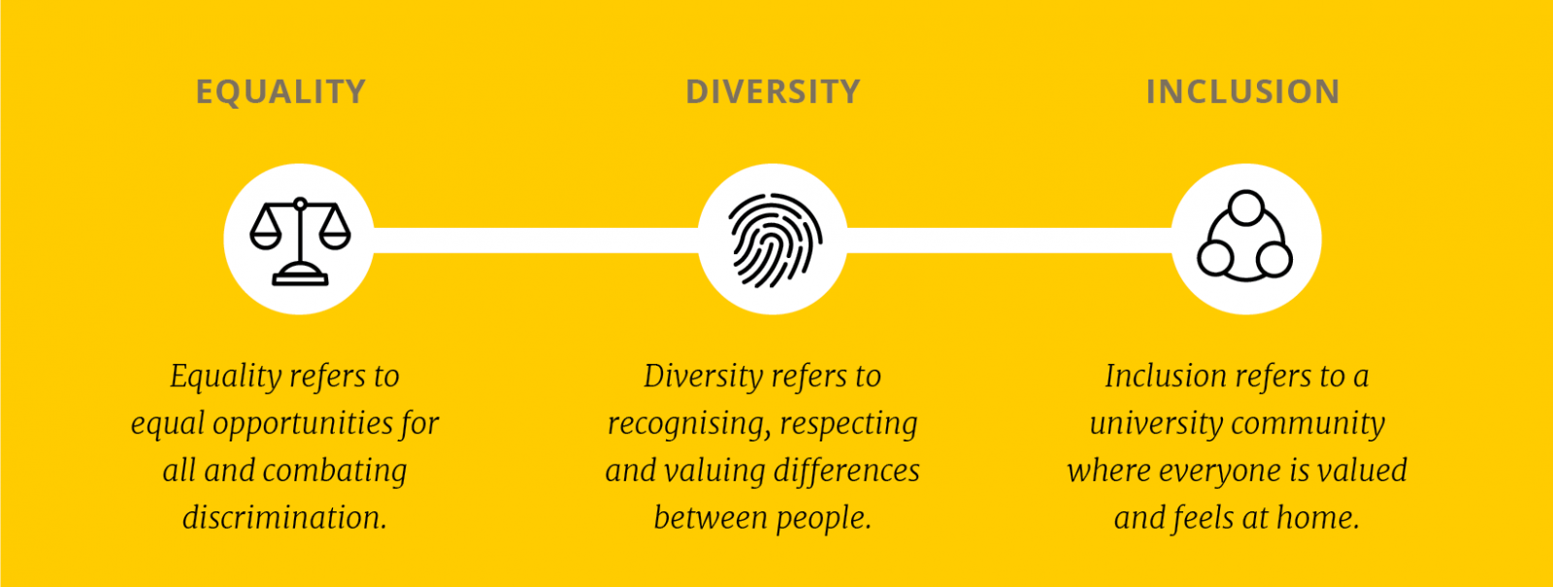
What does EDI mean?
EDI Programme - Equality, Diversity & Inclusion - Utrecht University (uu.nl)

Slide 5
Inclusive language
Use vocabulary that avoids biases, exclusion, and stereotyping based on someone's (minority) identity.
Use different sex instead of opposite sex (because this recognizes gender as a spectrum, rather than a binary).
Use they as singular pronoun → join the lunch meeting February 14th at 12:00.
Avoid normative terminology (terms such as other cultures or other languages implies that e.g. Dutch is the norm, and male nurse implies that female nurse is the norm).
Inclusive language | 18F Content Guide
UU Inclusive Teaching Toolbox | Inclusive Language
Notes:
UU Inclusive Teaching Toolbox | Inclusive Language
Inclusive language | 18F Content Guide

Slide 6
Assessment materials
Ensure that materials do not require or assume a certain level of understanding about one particular (i.e. Dutch) culture. For instance, international students are unlikely to understand the assignment if it contains words like ‘vmbo/havo/vwo’ which require familiarity with the Dutch educational system. Use examples that are culture-independent.
Select diverse cases (e.g. avoid stereotypes).
Select non-triggering cases (e.g. avoid racism, sexism, homophobia, transphobia, violence, war, abuse, rape and other forms of sexual violence, self-harm/suicide, eating disorders/body shaming).
UU Inclusive Teaching Toolbox | Assessment

Slide 7
Teaching materials
Make sure images are not integral to the content and/or describe images using alternative text.
Make your graphs colorblind friendly.
Select case studies/examples with care. Some topics may be triggering for students. If not relevant to the learning objectives, substitute triggering cases:
During a statistics lecture, an example was given to explain how to perform a certain statistical test. In this example, the means between anorexic patients who received different treatments were compared. One of the students in this class was recovering from anorexia at the time and was very much triggered by the low numbers that were discussed in this example which led her to having difficulties eating the rest of the day.
UU Inclusive Teaching Toolbox | Learning Materials
Notes:
UU Inclusive Teaching Toolbox | Trigger warnings

Slide 8
In the classroom
Avoid guys as a way to refer to mixed-gender groups. Use all or everyone instead.
Design accessible learning activities (e.g. wheelchair friendly ice breakers).
Avoid generalisations. Make sure to include all students in a discussion and make it explicit that a student’s perspective is not representative of their demographic/target group.
Consider adding a content warning for triggering cases:
“This lecture/video/article includes reference to/consideration of themes of x, y, z/ or images of x, y, z, which might trigger unwelcome and distressing memories or thoughts for some students.”
UU Inclusive Teaching Toolbox | Trigger warnings

Slide 9
Time for discussion!
How would you improve:
Inclusive language in class (and other communications)
Assessment materials
Teaching materials and examples
Classroom accessibility

Slide 10
Tips
Color blind friendly images:
Color Oracle simulator makes it easy to check if a certain colour combination would be easy or hard to see for people with different types of colour blindness.
Use the viridis R palette https://cran.r-project.org/web/packages/viridis/vignettes/intro-to-viridis.html
For graphs there is also https://colorbrewer2.org → click "colorblind-safe". Then in R you can palette(RColorBrewer::brewer.pal(name="<name>")).
Datasets:
In data science applications, the iris dataset is often used for classification examples, but every time you use that dataset, you refer to a publication in the "Annals of Eugenics". There are alternatives available such as palmerpenguins palmerpenguins R data package • palmerpenguins (allisonhorst.github.io).

Slide 11
Tips
The UU EDI project and toolbox:
EDI Programme - Equality, Diversity & Inclusion - Utrecht University (uu.nl)
Inclusive Curriculum and Learning Environment - Utrecht University (uu.nl)
UU Inclusive Teaching Toolbox | Universiteit Utrecht | Home

